Slide 1
International Marketing Analytics – Introduction
Dr Arne Floh
Senior Lecturer in International Marketing
arne.floh@wu.ac.at

Slide 2
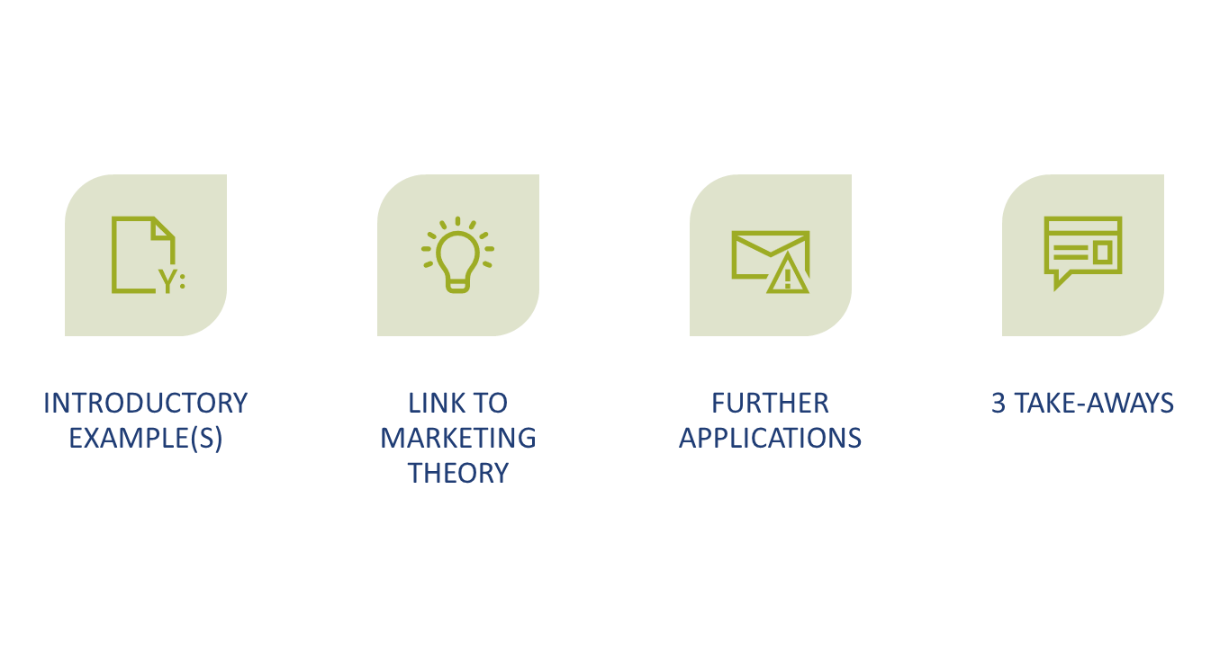
Overview

Slide 3
Introductory Examples

Slide 4
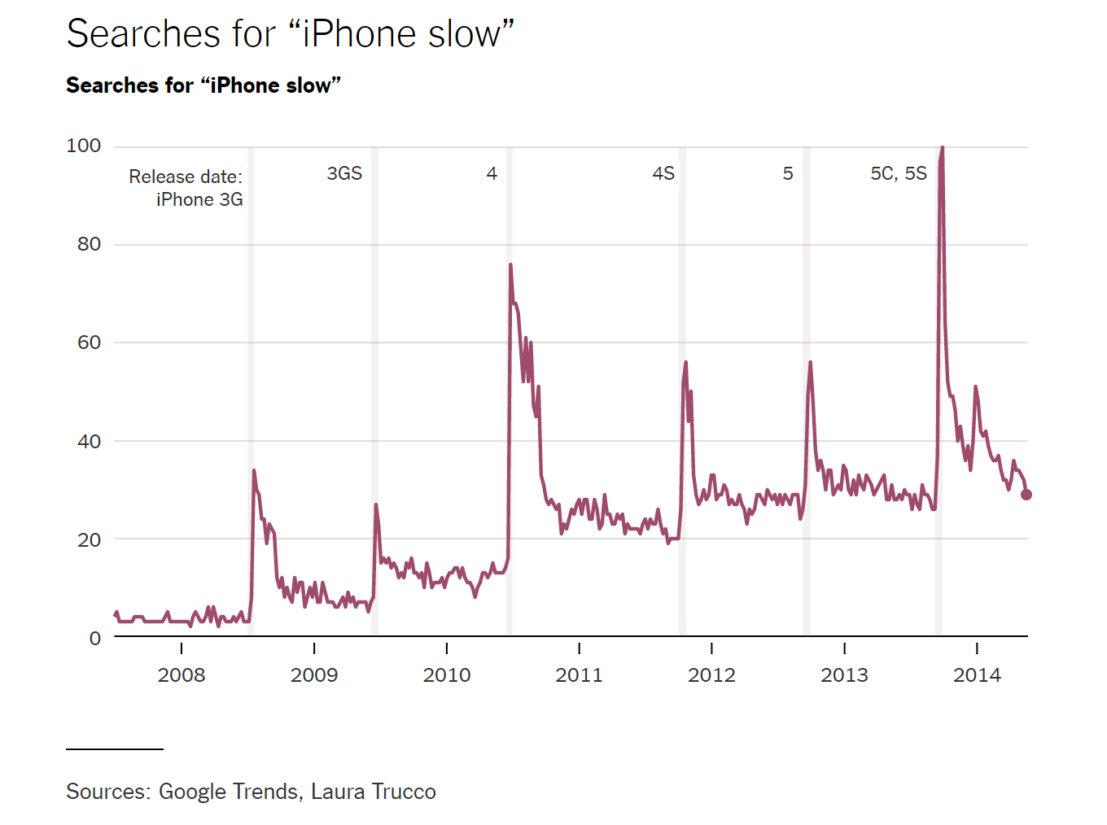
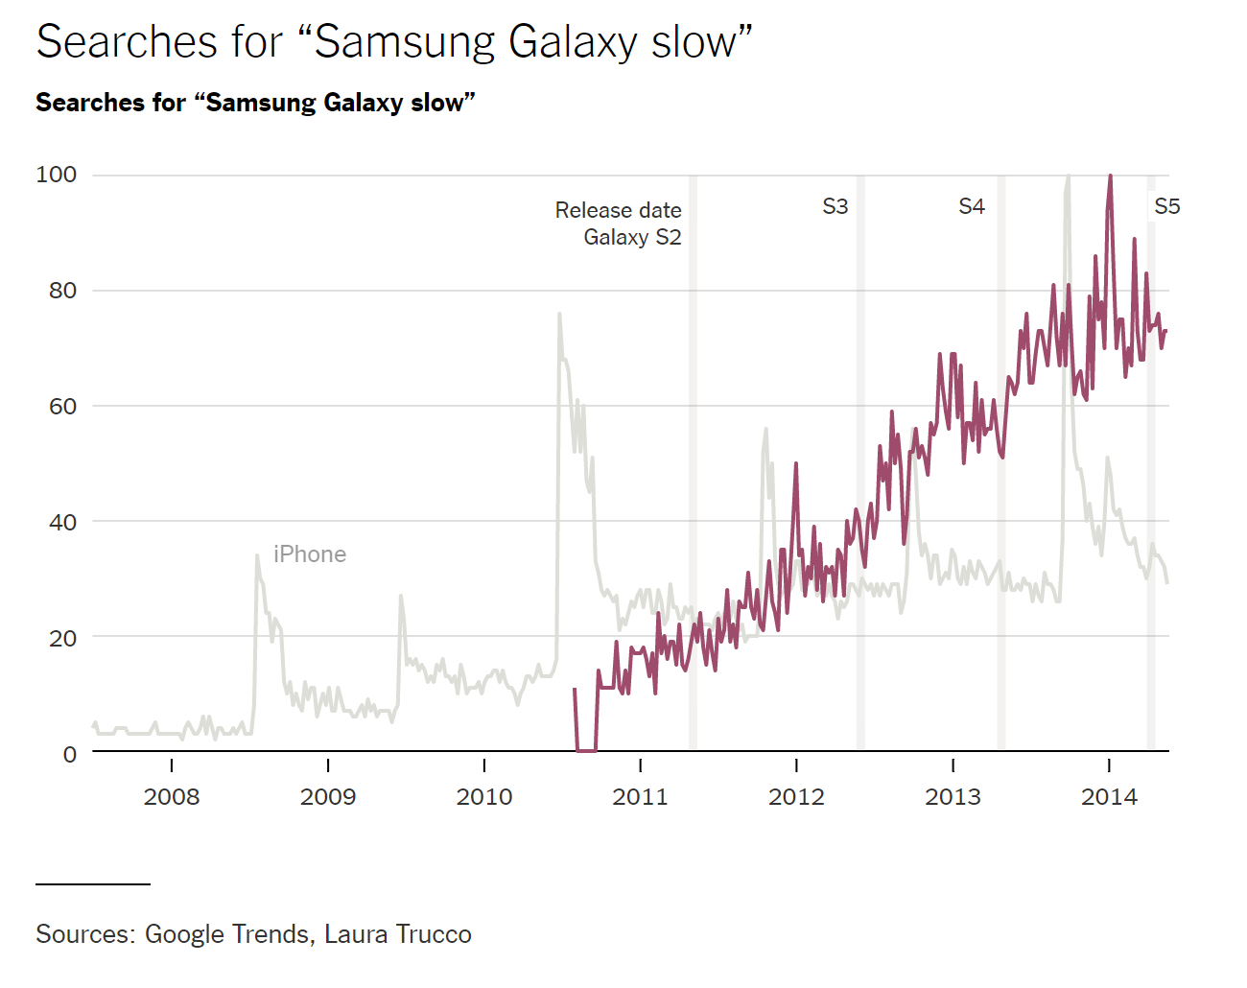
Example iPhone slow
https://www.nytimes.com/2014/07/27/upshot/hold-the-phone-a-big-data-conundrum.html
https://trends.google.com/trends/?geo=GB
https://en.wikipedia.org/wiki/Planned_obsolescence

Slide 5
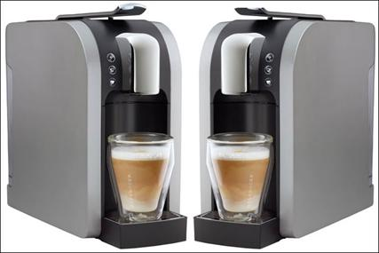
Example Starbucks – Product Launch
Starbucks has confirmed in 2018 the launch of its first entry into the luxury home coffee-machine market with Verismo, which will compete with Nescafé's Nespresso and other kitchen espresso makers.
The launch of the Verismo will form a key plank of Starbuck's UK growth strategy, as it moves to expand the business into new areas outside its core high-street stores. The move coincides with the chain's rollout of its first online shopping site in the UK, at www.starbucks.co.uk.
In the UK, the most expensive Verismo machine will cost £349, with a cheaper version priced at £149. The coffee pods will cost £5.99 for packs of 12. Verismo machines will initially be sold at starbucks.co.uk from tomorrow (21 September) and from Starbucks outlets from 2 November.
The Verismo has been developed with Krueger, a German-based company that sells in the US under the Keurig brand. The launch of the machines is expected to be supported by a significant marketing support. Kris Engskov, managing director at Starbucks UK and Ireland, said: "Up until today, making a Starbucks Latte at home was just not possible. Now customers who have been asking for more ways to enjoy Starbucks need look no further."

Slide 6
Why Marketing Analytics?
Marketing research supports managers by delivering information gained from different sources in order to achieve better decisions.
Usually, the marketing problem must be split down into different marketing research problems.
Consider the Starbucks example.
What is the marketing problem?
What kind of information do we need?
Why do we need this information?
Where do we get this information?

Slide 7
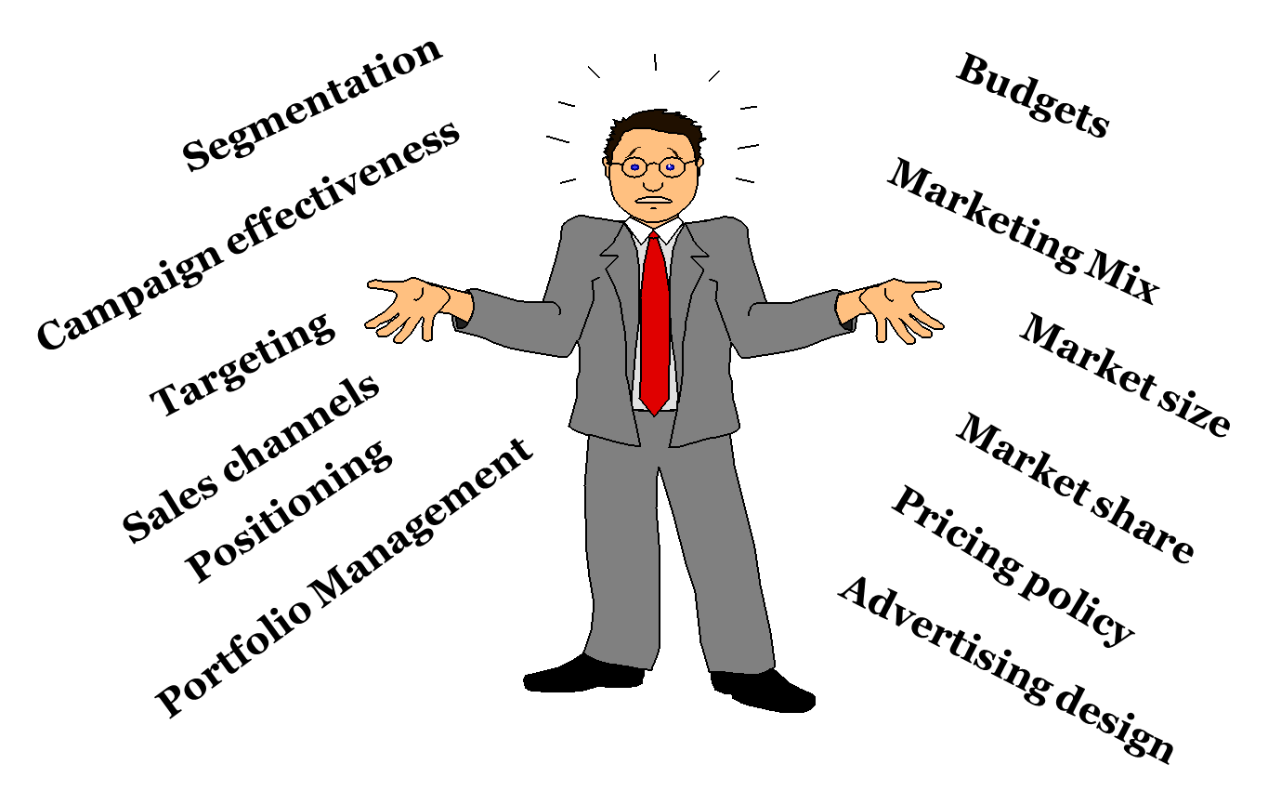
Decisions Made by Marketing Managers

Slide 8
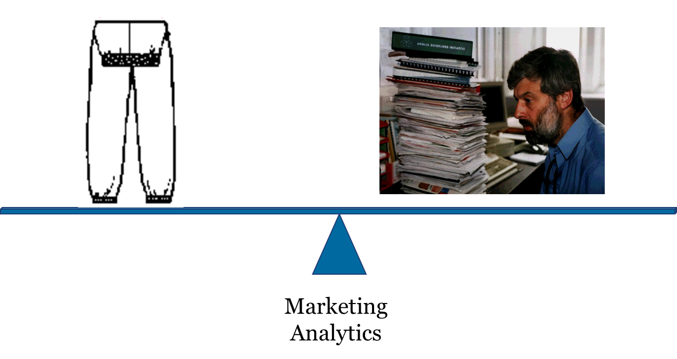
Developing the Right Balance Through Marketing Analytics

Slide 9
Link to Theory

Slide 10
Marketing Analytics
Marketing analytics can defined as
a systematic approach based data and knowledge to support marketing decisions and relies
relies on the simultaneous application of statistics, computer programming and operations research to quantify performance.
equivalent terms: Marketing Engineering, Marketing Science/ Intelligence, and Marketing Intelligence etc.
Even people who don’t particularly care for computers, software, or math can learn some systematic ways to think about marketing problems, and ask the right questions.

Slide 11
Trends Favouring Marketing Analytics
Marketing Analytics become more available /popular because:
The availability of the (too much?) marketing ‘big data’
  Volume (e.g., 500 Terabytes of transaction data at Wal-Mart)
  Dimension/source: e.g., the Nilsen data, and the IRI data
    Beyond big data: New perspectives on marketing – YouTube
    Digital device, tracking data, GDPR
Advance of computer power
Software: e.g., Excel, SPSS, SAS, R, Python to integrated solutions (e.g., IBM Watson)
Decentralization of organizations.

Slide 12
Applications of Marketing Analytics
Segmentation, targeting, and positioning, based on data
  To identify niche/overlooked segments
Customer value analysis
  Which of my customer relationships are profitable?
Evaluation of the effectiveness of marketing activities
  How deep of the price reduction?
  Buy-X-get-Y-free or Z% price off?
  Is the advertising campaign value for money?
Web metrics and social media analysis
  Do my social media expenses pay off?
  How many users/followers become customers?
New product design
  How to design the new product to more effectively appeal to target customers?
Sales forecasting
  Forecast the product sales for FMCG products
  Forecast the adoption of innovative products (e.g., electronic cars, auto driving)

Slide 13
Transform Data Into Insights and Actions
Marketing environment
Data
Data entry (objective and subjective)
Information
Organized/ summarizing the data
Insight
Decision model; mental model
Decisions
Judgment under uncertainty
Integrated with other resources (financial, human etc.)
Implementation

Slide 14
Concept of a (Response) Model
Marketing Actions
Observed Market
Competitive Actions
Inputs
Outputs
(2)
Product design
Price
Market
Awareness level
Advertising
Response
Preference level
Selling effort
(1)
Model
(4)
Sales Level
etc.
(3)
Environmental
Conditions
Control Adaption
Evaluation
(6)
Objectives
(5)

Slide 15
Are Marketing Analytics valuable?
Types of Subjective Objective
Judgments Experts Mental Decision Decision
Had to Make Model Model Model
Academic performance of graduate students 0.19 0.25 0.54
Life expectancy of cancer patients –0.01 0.13 0.35
Changes in stock prices 0.23 0.29 0.80
Mental illness using personality tests 0.28 0.31 0.46
Grades and attitudes in psychology course 0.48 0.56 0.62
Business failures using financial ratios 0.50 0.53 0.67
Students’ rating of teaching effectiveness 0.35 0.56 0.91
Performance of life insurance salesman 0.13 0.14 0.43
IQ scores using Rorschach tests 0.47 0.51 0.54
Mean (across many studies) 0.33 0.39 0.64

Slide 16
Top Perfomers use Marketing Analytics
High Low
Performers Performers
65% Have significant decision-support/analytical capabilities 23%
36% Value analytical insights to a very large extent 8%
77% Have above average analytical capability within industry 33%
77% Have BI/Data Warehouse modules installed 62%
73% Make decisions based on data and analysis 51%
40% Use analytics across their entire organization 23%

Slide 17
Further Applications

Slide 18

What Walmart did on 09/11
Within a few hours of the 9/11 attacks, sales of flags and other patriotic items started skyrocketing.
On Sept 11, the 2,700 Wal-Mart stores sold over 100,000 flags (compared to 6,400 the previous year on that day), and over 200,000 on Sept 12th.
Detecting these increases, Wal-Mart locked up all the supplies it could find before its competitors (like Kmart) could react.
Real-time tracking and analysis helped cope with a demand surge.

Slide 19
Take Aways

Slide 20
Take-Aways
Exposed to massive data sets, marketers who master some data mining and marketing analysis techniques have the competitive advantage in this information age.
Marketing analytics is a comprehensive information system which helps marketers to balance the overloaded marketing data and the need for rich marketing experience.
Marketing Information System (MIS) is designed to generate, analyse, distribute and store the anticipated marketing decision information. It serves the internal information users, meanwhile, provides information to external stakeholders.

